Slide 1
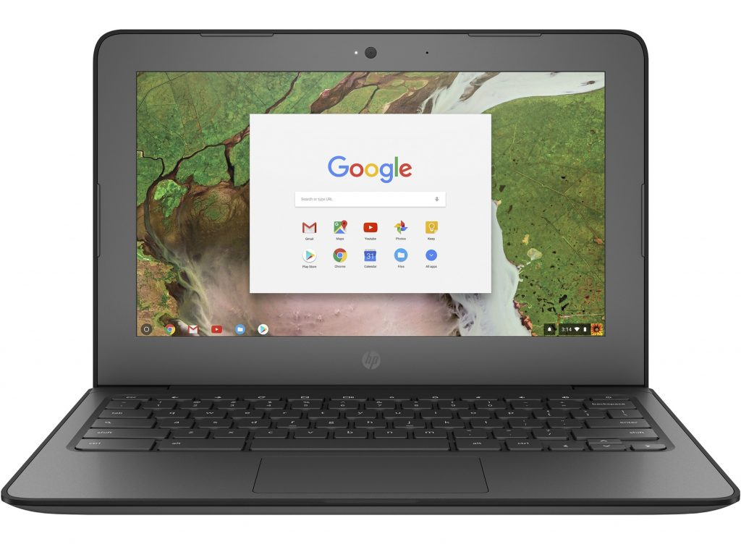
Welcome To New Tech West
* Login Information*

Slide 2
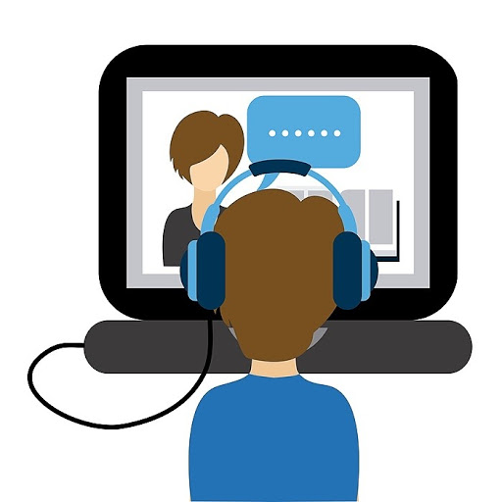
Table of Contents
(click the one you need)
Computer login with GMHS
Computer login with CMSDK12
ECHO Login
How to log into Virtual class (Office 365 and Teams)
Clever login
How to Update Chromebook

Slide 3
Computer login with GMHS
Type in your Student ID for your password
EX: Student ID: 209000209
Type in your GMHS Email:
First.Last@gmhs.cmsdnet.net
For email help contact: elaine.fourtounis@gmhs.cmsdnet.net

Slide 4
Login with CMSDK12
Password is capital letter of your first name then 5 digit lunch code and ends with two lower case letters of the first letter of your first name.
EX: My name is New Tech and my lunch code is 11801
My password is: N11801nn
Email emily.wobser@gmhs.cmsdnet.net if you need your lunch code.
This is the same as your AR login for those who know theirs.
Login with
First.Last
NOTICE THE @CMSDK12 IS ALREADY THERE, SO DON’T TYPE IT.

Slide 5
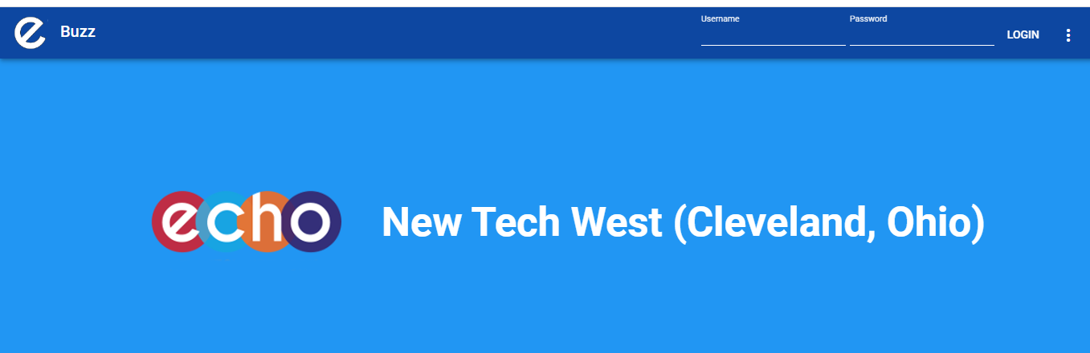
Log into ECHO
User Name is
Firstname.Lastname
Password is your
Student ID (9 digits)
Website url
https://newtechwest.echo-ntn.org/
Echo Login help:
Shannon.lynch@gmhs.cmsdnet.net or Elaine.Fourtounis@gmhs.cmdnet.net
MAKE SURE IT SAYS NEW TECH WEST

Slide 6
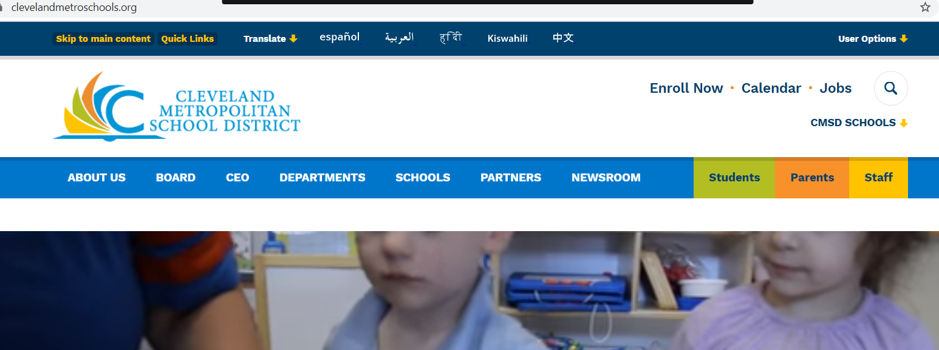
Log into Class
First step you need to be logged into office 365
Go to Cleveland’s website - clevelandmetroschools.org
Click Students

Slide 7
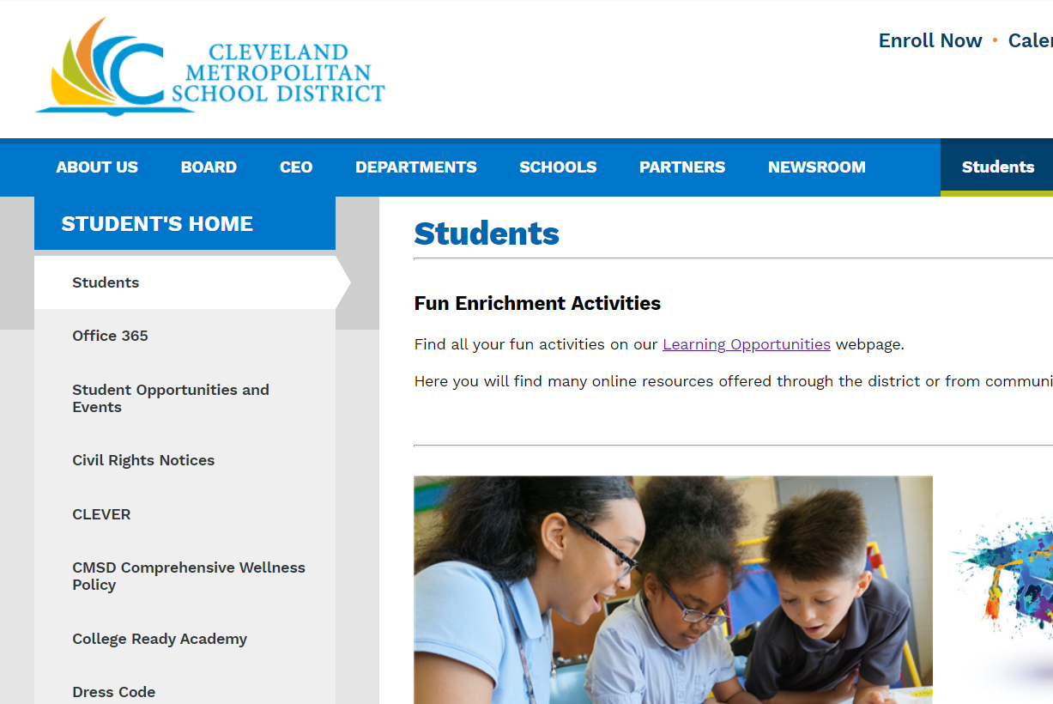
Log Into Class
Click Office 365

Slide 8
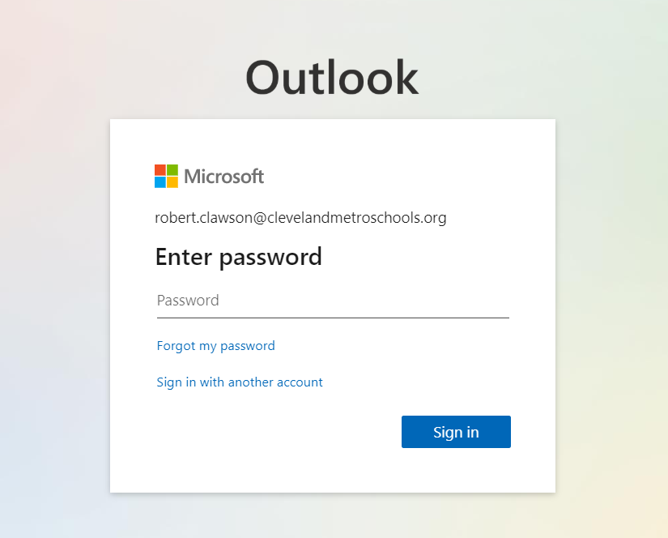
Password is Capital letter of your first name then 5 digit lunch code and end with two lower case letters of the first letter of your first name.
EX: my name is New Tech and my lunch code is 11801
My password is: N11801nn
Email emily.wobser@gmhs.cmsdnet.net if you need your lunch code.
This is the same as your AR login for those who know theirs
Login to Office 365 email
First name.last name @CMSDK12.org

Slide 9
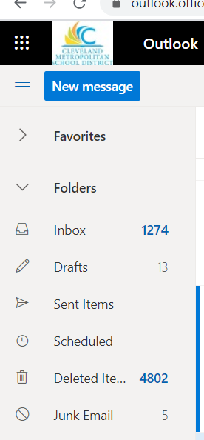
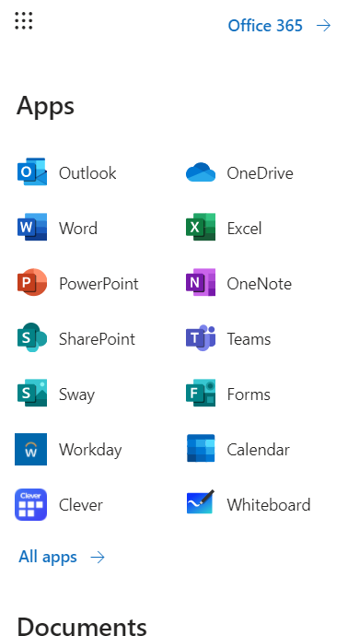
Now login to teams
In the top left there are nine dots. Click them.
Now click Teams and find the name and period of your class

Slide 10
CLEVER LOGIN
1st
Go to clevelandmetroschools.org
Click Green students tab (1st)
Click Clever(2nd)
Click Log in to CLEVER and use your CMSDK12 login information - see slide 4
**** If you are already logged into your CMSDK12 email you can also click LOG IN WITH ACTIVE DIRECTORY and it will take you straight there(see next slide).
2nd

Slide 11
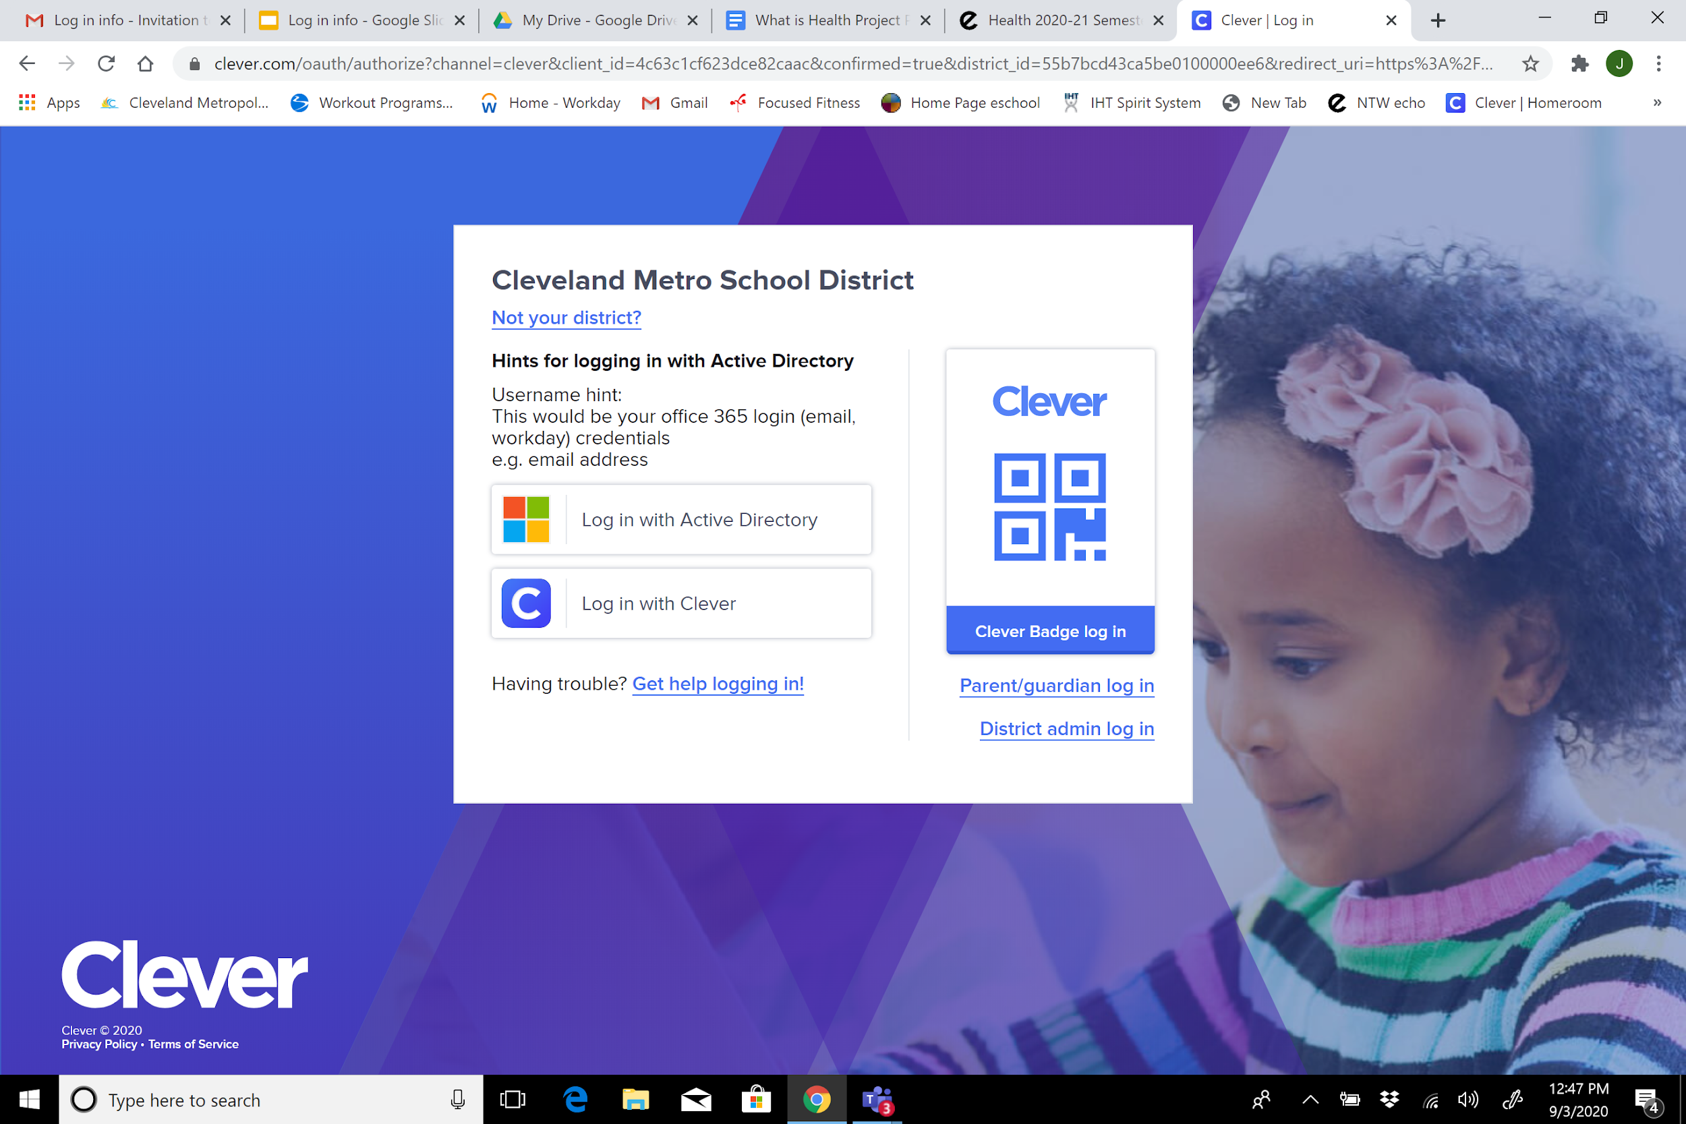
Click here

Slide 12
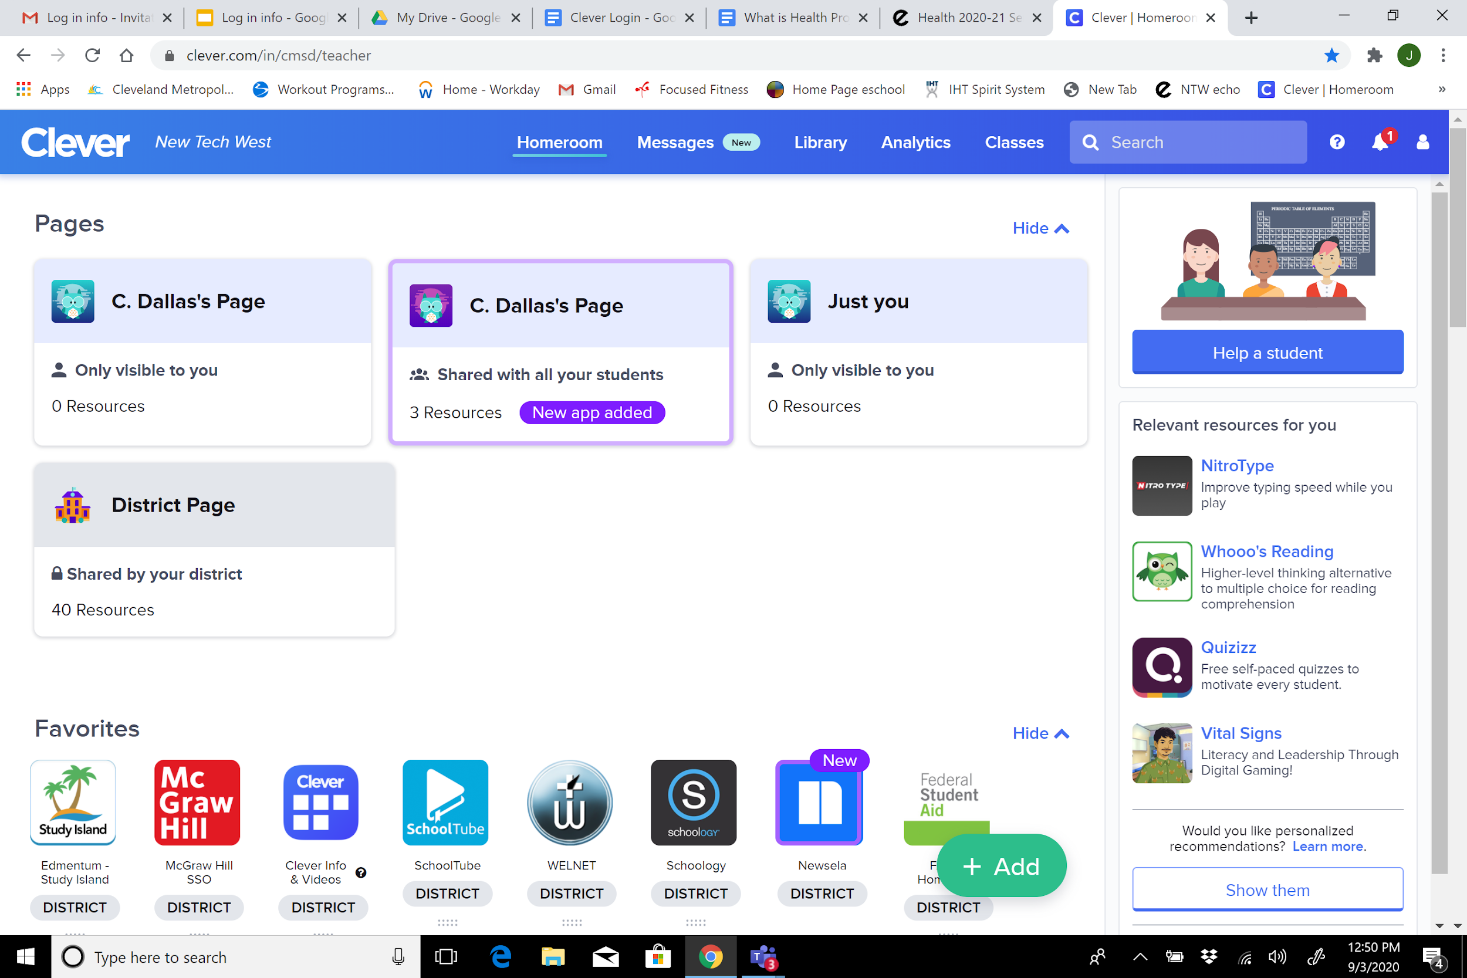
Search for various apps/tools above
Use the above pages to find teacher-specific apps
Find an individual app by scrolling down and clicking on it

Slide 13
CHROMEBOOK UPDATE
To know if the chromebook truly did update students will have to do the following:
Check for updates yourself
Turn on your Chromebook.
Connect your Chromebook to Wi-Fi.
At the bottom right, select the time.
Select Settings
At the bottom of the left panel, select About Chrome OS.
Under "Google Chrome OS," you'll find which version of the Chrome operating system your Chromebook uses.
Select Check for updates.
If your Chromebook finds a software update, it will start to download automatically.
Note: If your Chromebook uses your phone's internet connection or its own mobile data, you'll get an alert about how much mobile data it needs to update. You can then stop or continue with the update.
Visual Step by Step directions ( share this via email with your students and it will also be included in our troubleshooting tech presentation on our school website
Video Below
https://partnerdash.google.com/apps/simulator/chromebook#update-your-chromebook?l=en

